Slide 1

Dungeons and Dragon App
Ryan Butler, Zhiyang Huang, Sean Mcparland, Justin Donovan Paez,
Tyler Templeton

Slide 2
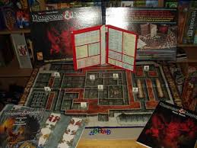
What Is Dungeons and Dragons?
Fantasy role-playing game
Dungeon master
Dice
Imagination
Notes:
fantasy role-playing game set in an imaginary world based loosely on medieval myth.

Slide 3
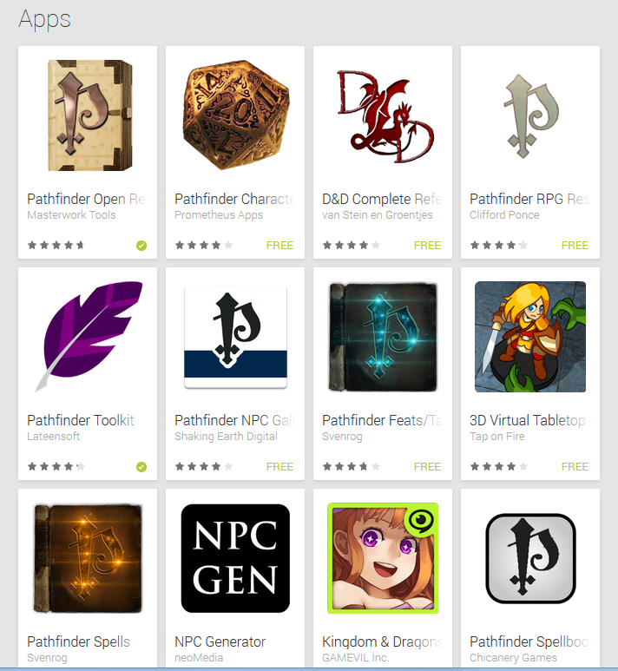
Why Build The App?
Lots of D&D apps
No all in one app

Slide 4
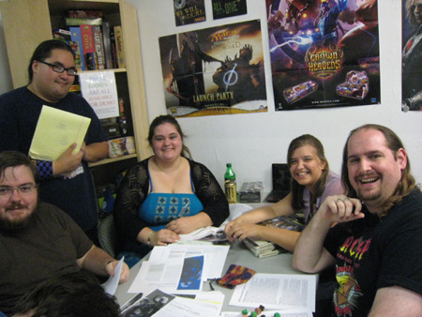
Who is this for?
Mostly Male
Age 20-40
More tech focused

Slide 5
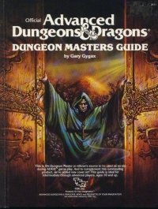
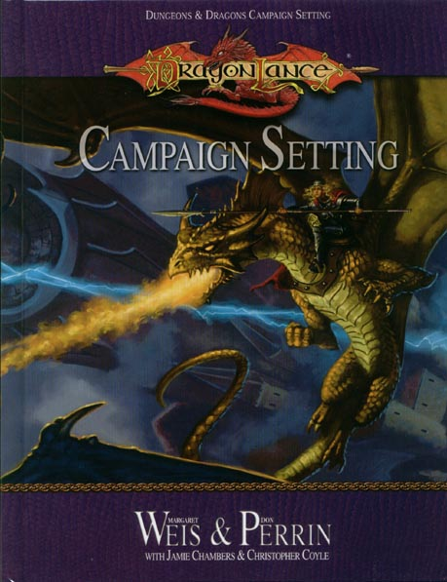
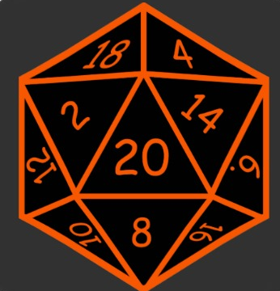
User survey
Top Features
Rules Compendium
Campaign design
Lowest Features
Dice roller

Slide 6
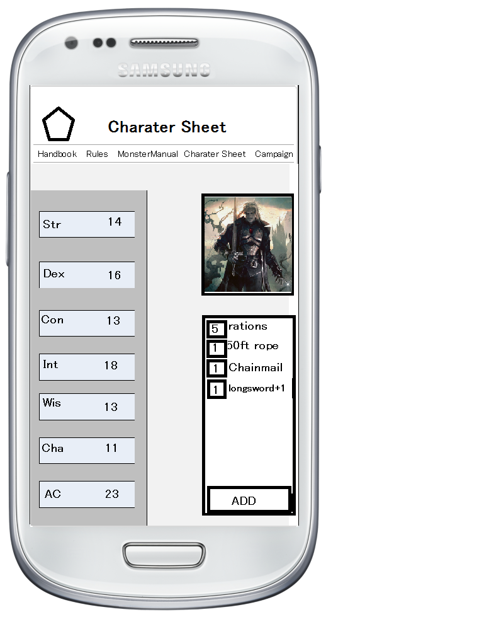
Initial Wireframes
Findings
Unsure what was “clickable”
Would like more colour
Sizes could be an issue

Slide 7
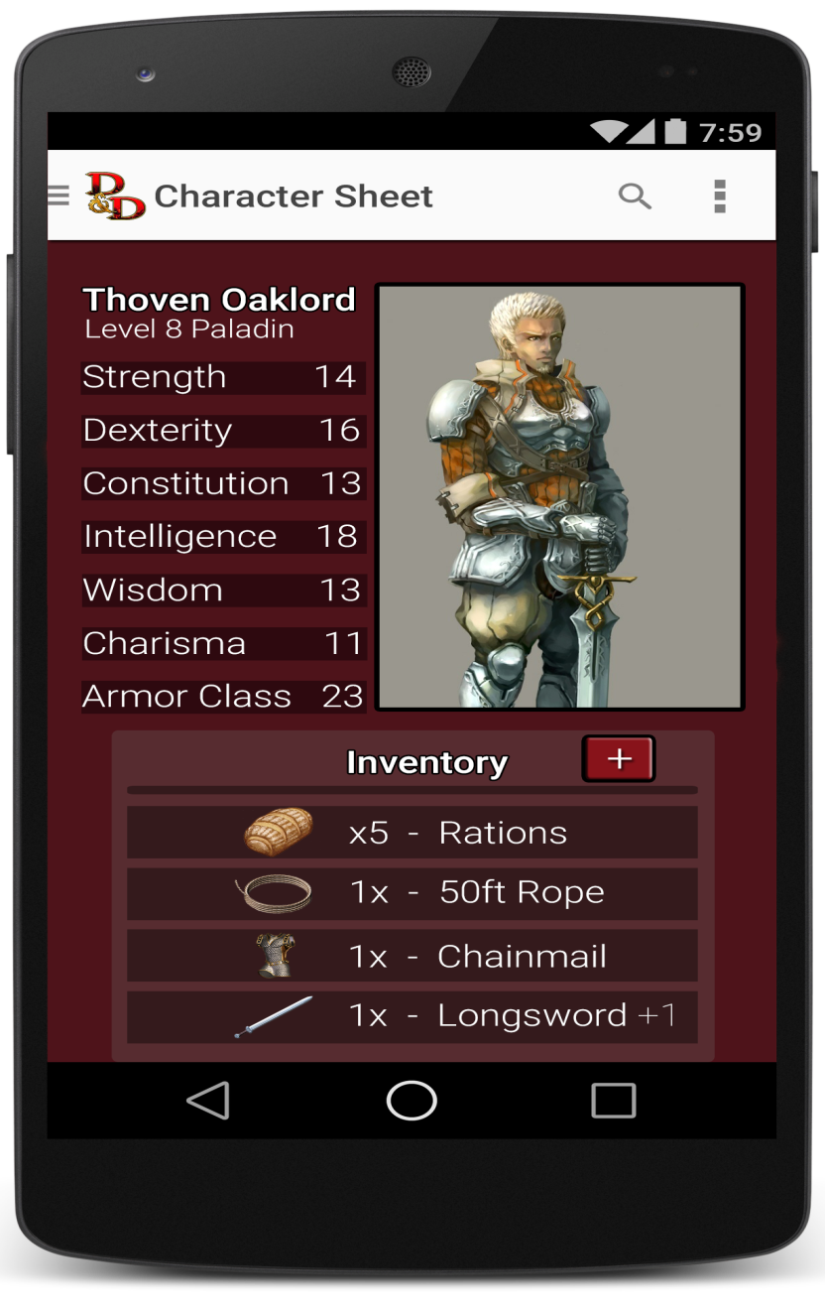
Revised Wireframes
Added more colour
Easier to scale
Made buttons look more “clickable”

Slide 8
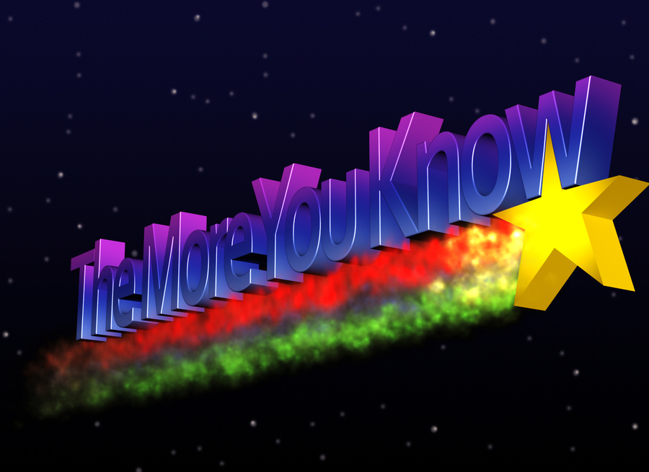
Lessons Learned
Paper testing confuses testers
Compiling data from user took too long

Slide 9
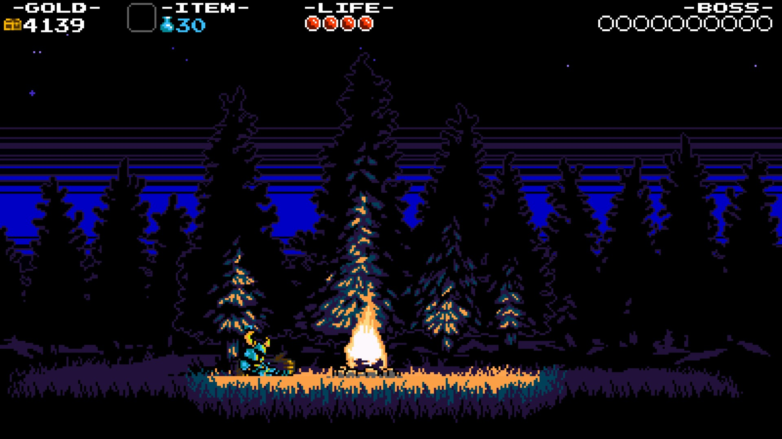
Thank You For You Time!

